Slide 1




HackOrbit 2025
Team Name : “Pixel Pirates”

Slide 2
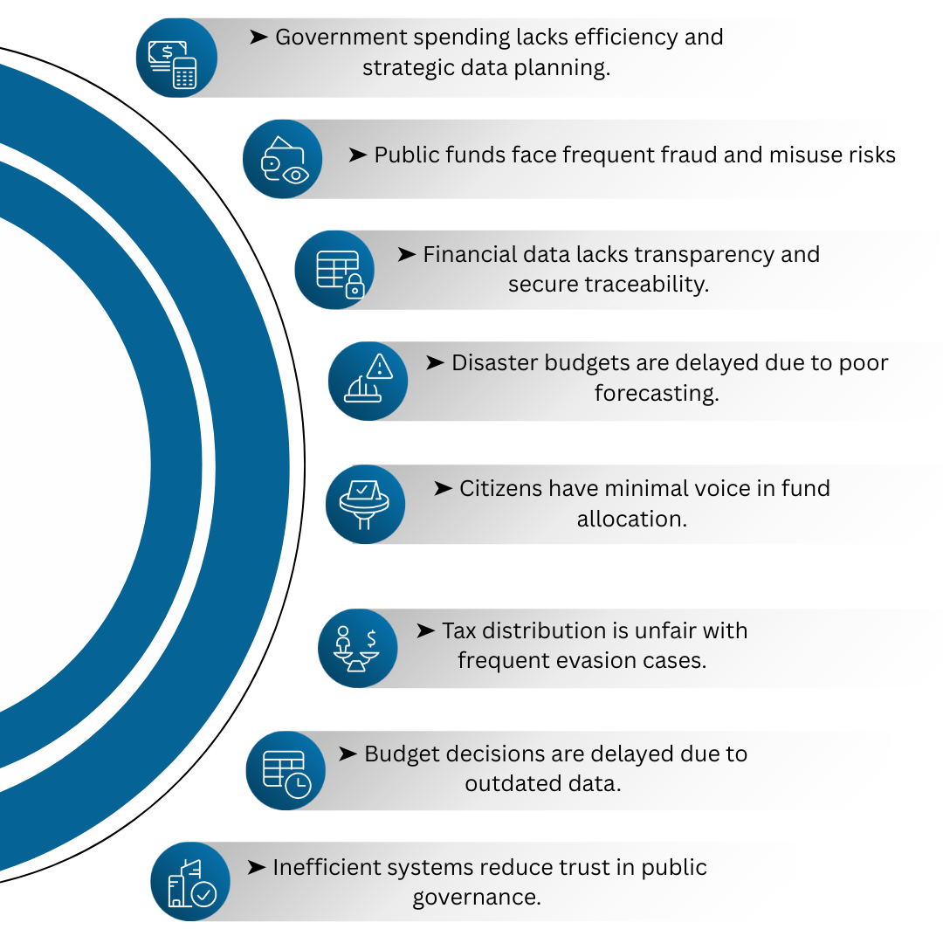

Smart Bharat Budget AI — Revolutionizing India’s Budget Planning with Artificial Intelligence
Where Did the Idea Comes From ?
During our internship at a government office, we came across a shocking disaster report that changed everything. Hospitals were underfunded during emergencies, while other departments sat on unused budgets. This raised a haunting question: Who’s responsible when lives are lost due to poor planning and misallocation?
This eye-opening discovery sparked the idea for the Smart Budget Allocation System — an AI-powered platform that ensures every rupee counts. It leverages AI for need-based planning, blockchain for real-time transparency, and public voting for democratic fairness, making government budgeting smarter, faster, and more accountable to the people it serves.
Problems in Traditional Budget Governance
What is smart bharat budget AI?
Smart Bharat Budget AI is an intelligent, transparent platform that uses AI and blockchain to optimize India’s rural fund allocation. It forecasts budgets, detects fraud, enables public voting, and ensures fair distribution. The system empowers government and citizens through real-time insights, transparency, and inclusive decision-making for smarter budget planning.
Project Goal
Develop AI-powered system to optimize fund distribution, fraud detection, and financial forecasting.

Slide 3
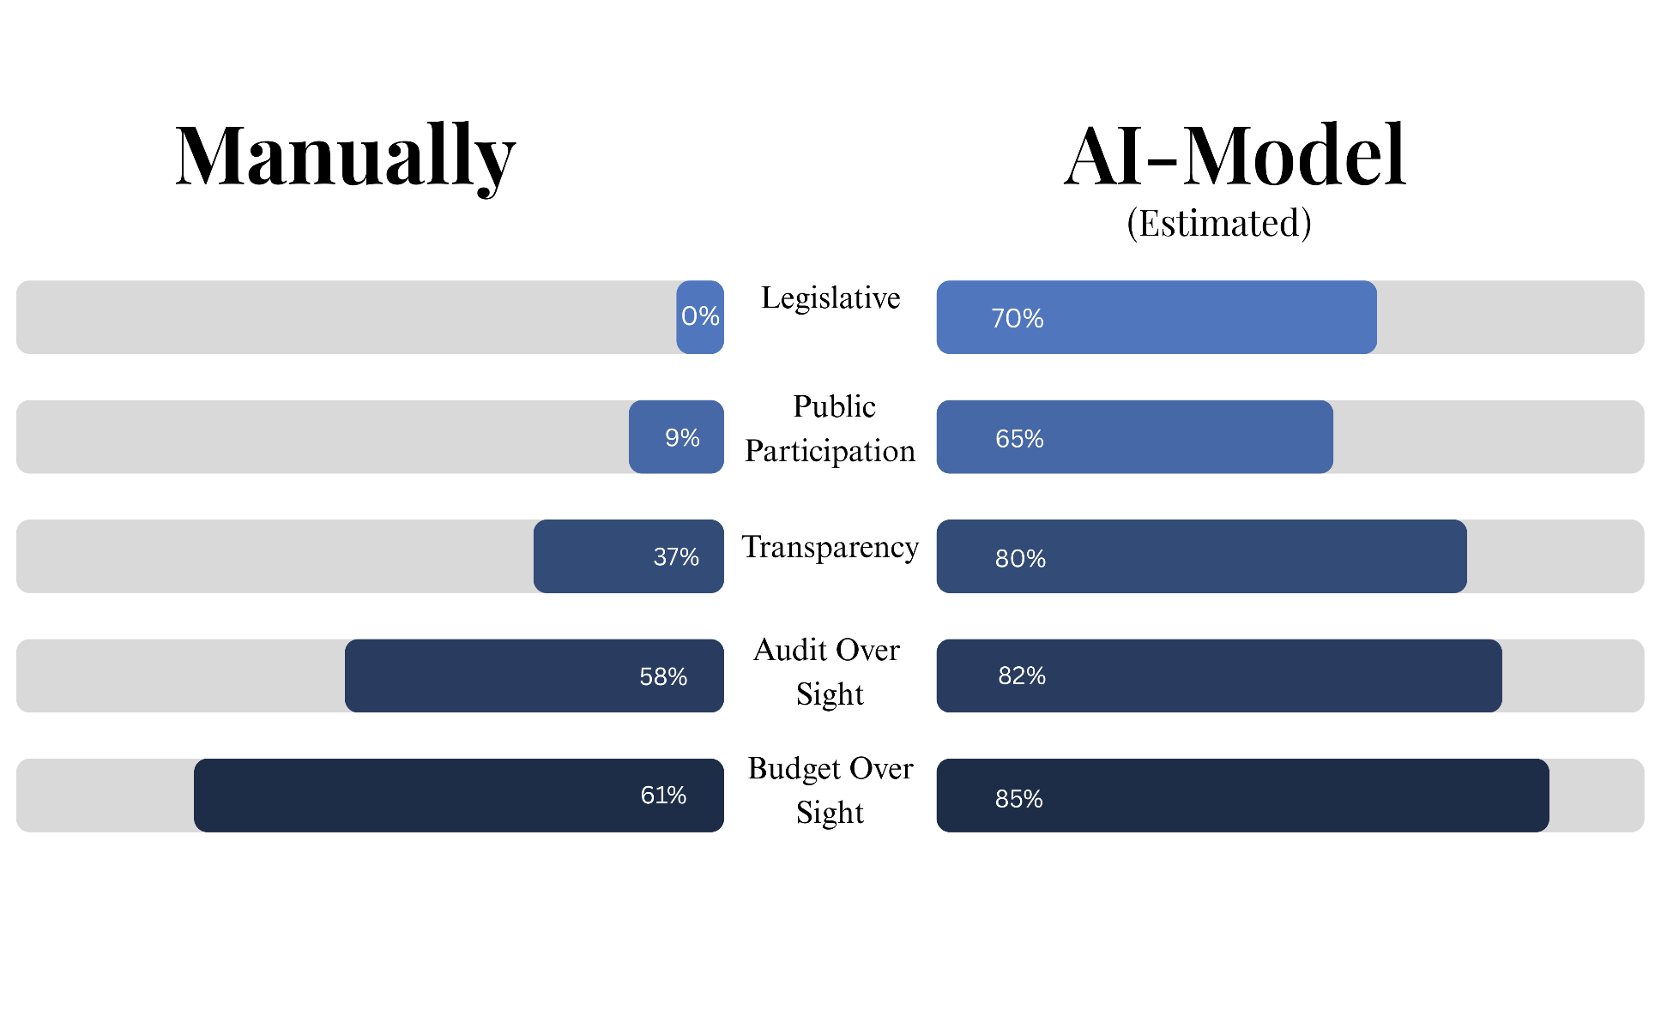
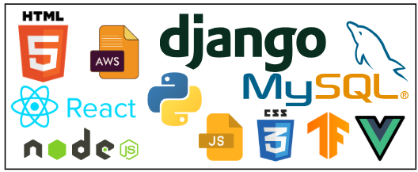
Proposed Solution / Big Idea
Proposed Solutions
Impact
Develop an AI-powered system for budget forecasting, trend analysis, and fraud detection.
Use blockchain for transparent, tamper-proof fund allocation.
Create web and mobile dashboards for real-time financial insights.
Implement AI-based disaster risk assessment for emergency fund planning.
Introduce blockchain-based public voting for democratic budgeting.
Apply Generative AI for tax optimization and compliance.
Enable public feedback to boost accountability.
Act as a government advisory and citizen engagement tool.
Technological Stacks
Frontend: React.js, Vue.js, D3.js
Backend: Node.js, Django
AI/ML: TensorFlow, PyTorch (budget prediction, fraud detection)
Blockchain: Ethereum, Hyperledger (voting, transparency)
Database: PostgreSQL, MongoDB
Cloud/Security: AWS, Azure, OAuth, SSL/TLS
APIs: RBI, IMF, NASA (financial/disaster data)

Slide 4
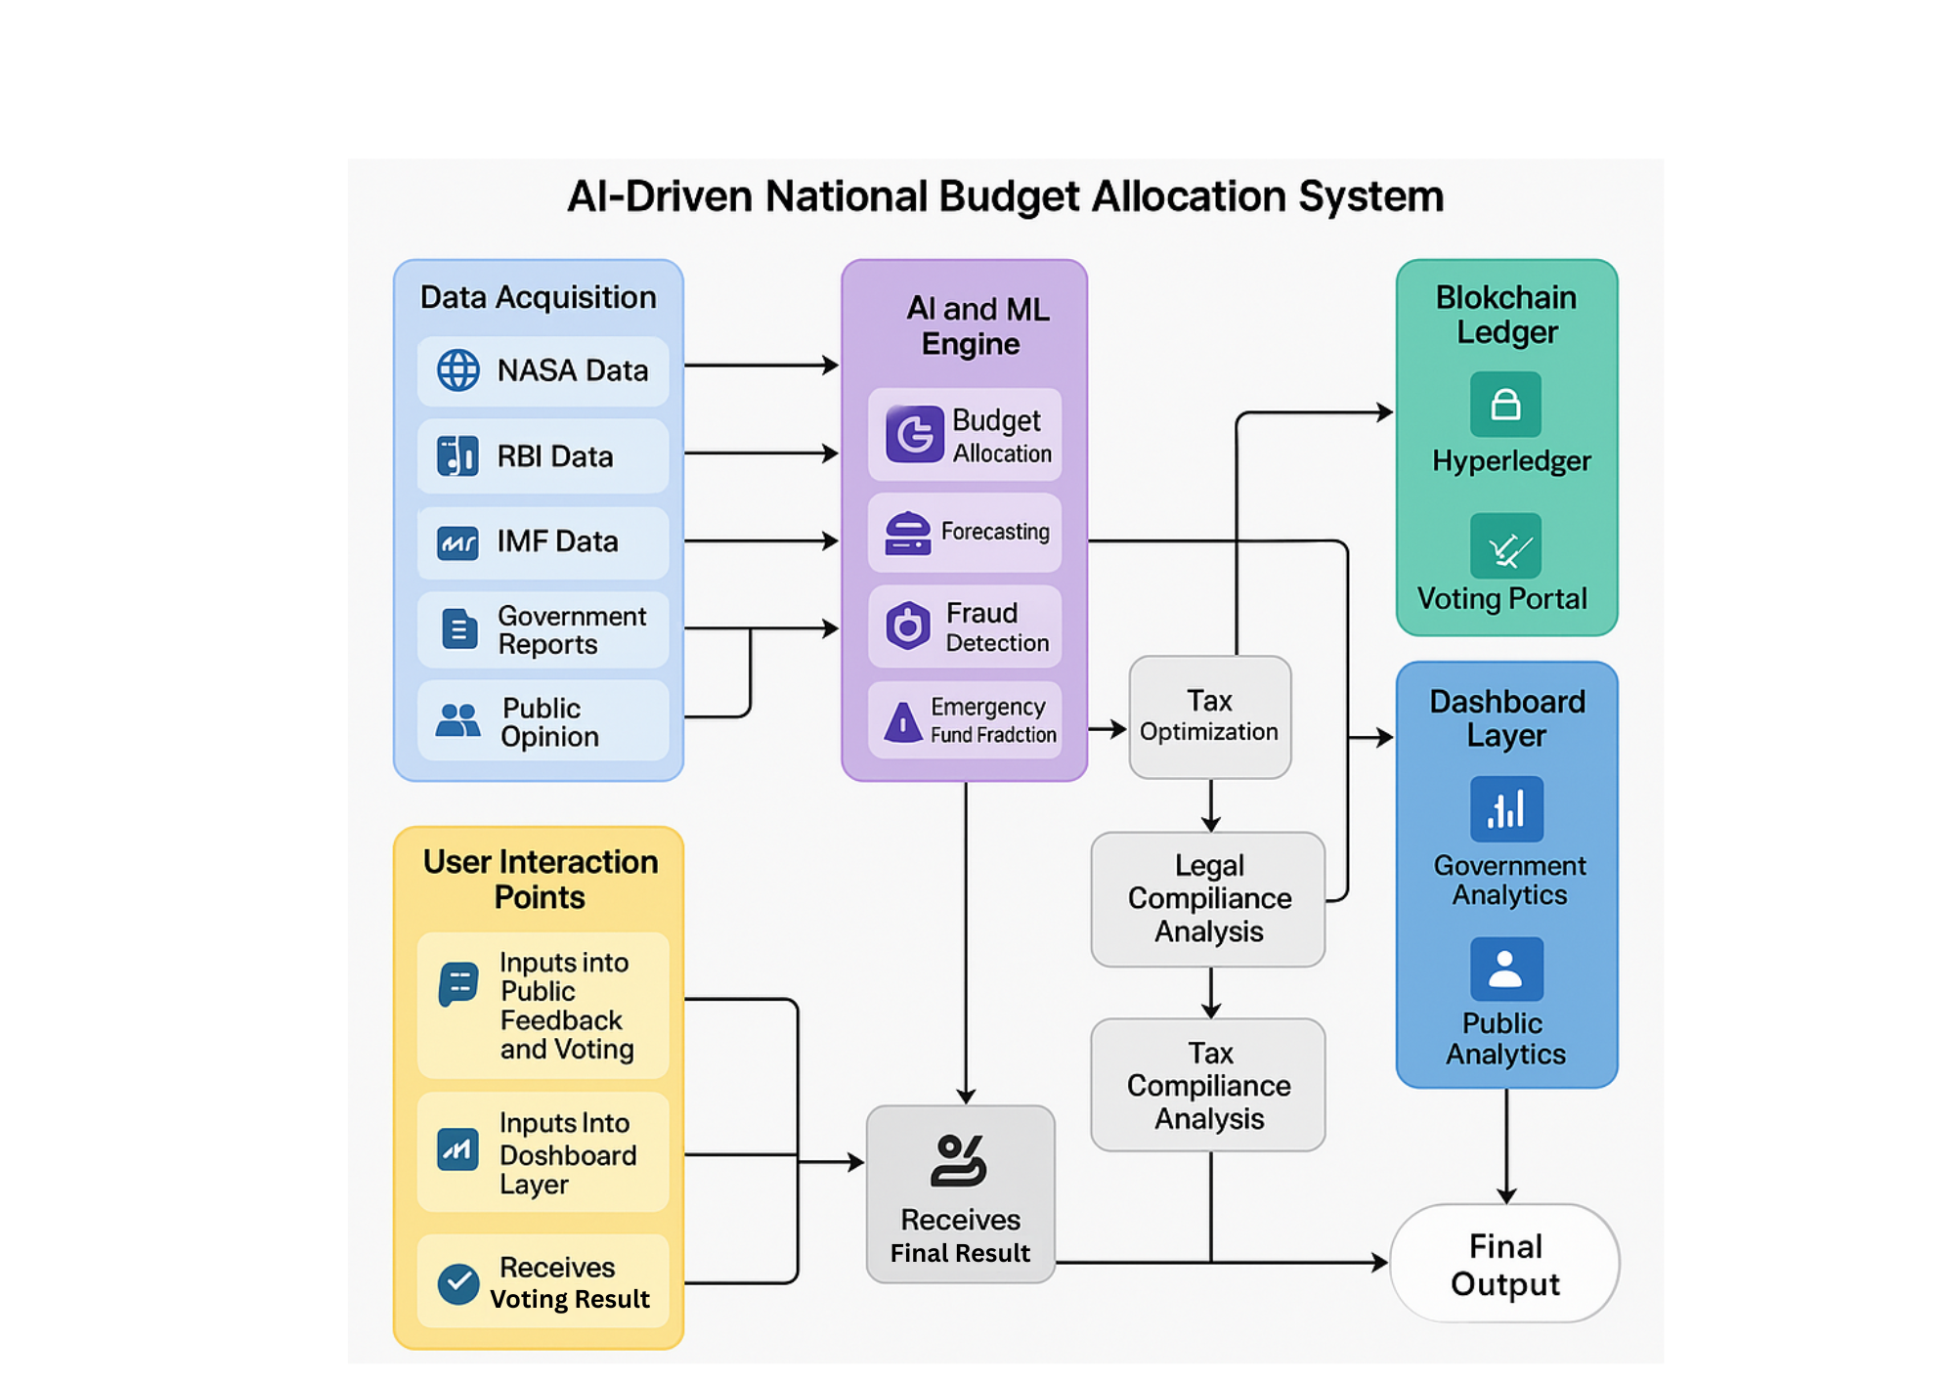
Flowchart / Diagram

Slide 5
FLOWCHART / DIAGRAM (Explainer text)
)
Data Acquisition:
The system gathers data from key sources like NASA (for disaster forecasting), RBI and IMF (economic stats), government reports (past budget records), and public opinion (social media, surveys).
Blockchain Ledger:
Hyperledger tracks internal government fund flow.
Voting Portal records citizen votes on budget priorities using blockchain for full transparency.
AI and ML Engine:
Budget Allocation – Distributes budget intelligently across sectors.
Forecasting – Predicts future needs using historical and real-time data.
Fraud Detection – Identifies suspicious financial activities or misallocations.
Emergency Fund Prediction – Anticipates future disasters and allocates funds proactively.
Tax Optimization Module: Analyzes budget impact on taxation, ensuring optimal revenue generation.
Legal Compliance Analysis: Verifies whether budget decisions adhere to legal norms and frameworks.
Tax Compliance Analysis: Detects tax fraud, evasion patterns, and pending litigations using AI.
Dashboard Layer:
Public Analytics shows users voting results and budget distribution.
Government Analytics provides detailed visualizations and AI reports for decision-making.
User Interaction Points:
Citizens input feedback and vote.
Final output is delivered to both public and government for action.

Slide 6
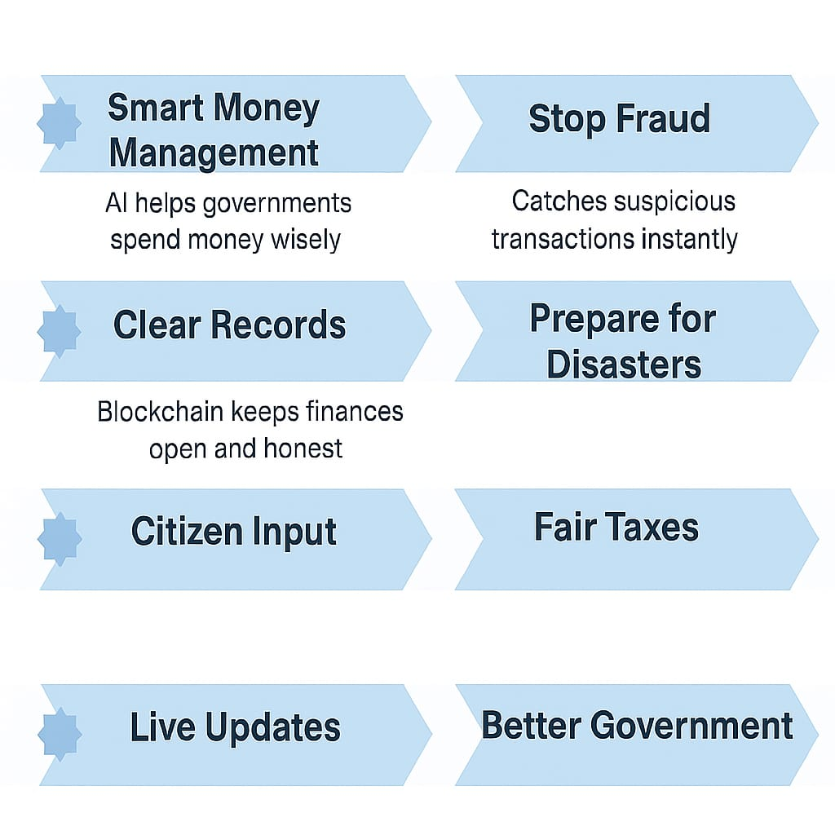
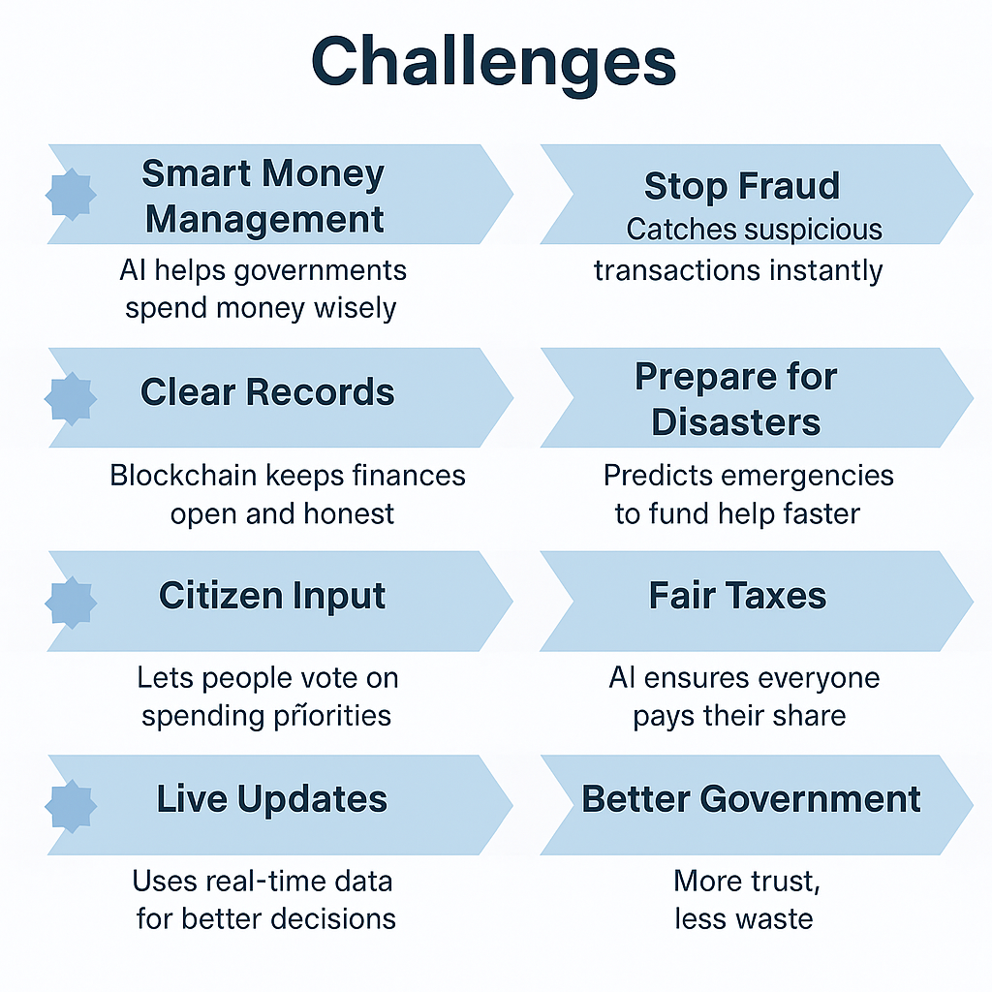


Key Features And Novelty
AI-Powered Capabilities
How is our solution different/unique from other solutions in market?
Features
Our solution
Market Alternatives
Decision- Making
🧠
AI-driven optimization (ML + forecasts)
Manual/historical-based allocations
✅
30% waste reduction (AI-optimized)
Cost Efficiency
10-15% savings (basic digitization)
Flexibility
Rigid annual/
quarterly cycles
🔄️
Real-time dyna-mic reallocation
Public Participation
Limited citizen input (surveys only)
🗳️
Voting + sentiment analysis
Reactive emergency budgets
Disaster Response
⚠️
Predictive crisis funding

Slide 7








Barriers to Success
⚠ Drawbacks
❌Showstoppers
📊 Data Issues: Outdated or wrong data can reduce AI accuracy.
🚫 No Political Support: Without backing, the project may never launch.
🌐 Digital Divide: Rural citizens may lack access to digital tools.
🔐 Cyber Risks: Data breaches can break transparency and trust.
🤖 AI Bias: AI results can be unfair or hard to explain.
📜 Legal Barriers: Blockchain use may not be allowed by law.
⚙ Integration Issues: Connecting with old systems may take years.
💰 High Costs: Big investment needed without government funding.
⛔ Resistance: People may not easily trust AI decisions.
🕵‍♂ Privacy Concerns: Using personal data may raise ethical issues.

Slide 8

Team Name : Pixel Pirates
Team members :-
Snehal Kolhe
Email : harikolhe2628@gmail.com
Contact no. : 8010762086
Prem Patil
Email : Premtemp74@gmail.com
Contact no. : 7499533550
Kalpesh Patil
Email : kp418099@gmail.com
Contact : 9503249509
Vanshika Dawani
Email : vanshikadawani2006@gmail.com
Contact : 9022522917

Slide 9
Thank you
“We Aim To Make Every Rupee Count”
Youtube video link : https://youtu.be/ncs3qi1p6Y4

